Slide 1
The Fiscal Reconciliation Workbook
Charise Proctor, Assistant Director, Prince George’s County Office of Child Support
Aileen Hoyle, Supervisor, Prince George’s County Office of Child Support

Slide 2
Purpose
In this session the audience will learn how to utilize the Fiscal Reconciliation Workbook.
The audience will also learn the logistics of the programming

Slide 3
Background
The Prince George’s County Office of Child Support is a Metro Jurisdiction with over 33,000 cases.
There was a great need and a lot of requests for monthly reconciliations that were done manually which made them time consuming.
The idea for the Fiscal Reconciliation Workbook came from Charise Proctor in 2015.
Charise Proctor asked Aileen Hoyle to implement the idea.

Slide 4
What is the Fiscal Reconciliation Workbook?
The Fiscal Reconciliation Workbook is an Excel document that helps calculate the case balances on child support cases.
It is used to ensure that the balance matches the court order and payment activity on the case.

Slide 5
Definitions Used in this Presentation
Support Ordered Amount (SOA) – The monthly court ordered child support amount.

Slide 6
Workbook Layout
Payment Summary Tab – All payment and court order information is entered here.
PAGES 1 to 8 - The month-by-month reconciliation tabs.
Fiscal Reconciliation Summary – A coversheet with the case and court order information.

Slide 7
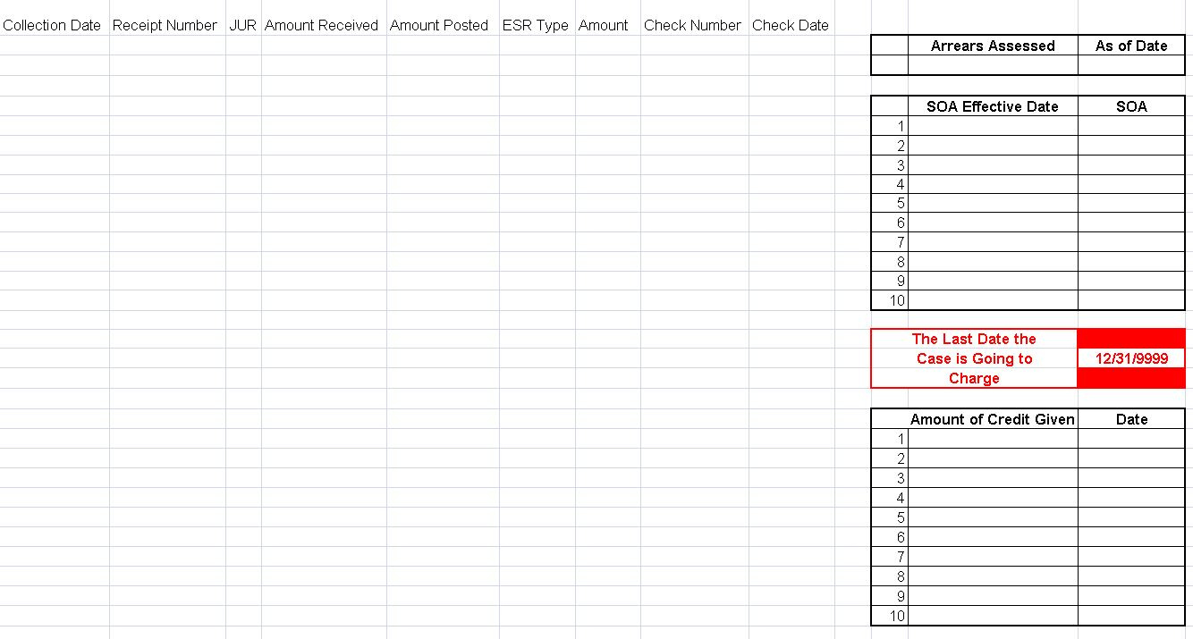
Payment Summary Tab
All payment and court order information is entered on this tab.

Slide 8
Payment Summary Tab cont.
The CSES Payment Summary can be downloaded as an Excel spreadsheet which is then pasted into the Fiscal Reconciliation Workbook.
Therefore, the headings for the Payment Summary section match the headings of the CSES Payment Summary Screen.

Slide 9
Payment Summary Tab cont.
The Payment Summary Tab allows for up to 20,000 lines of payment information.
The red line indicates this limit.

Slide 10
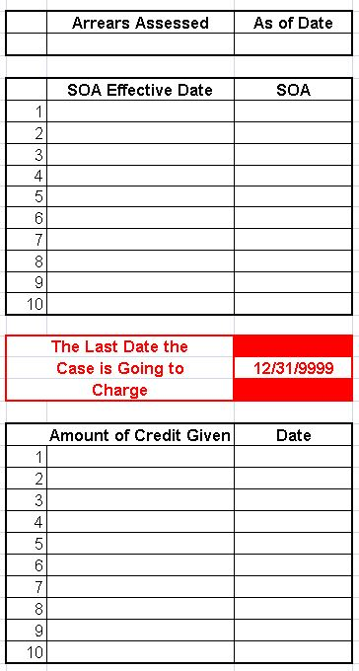
Payment Summary Tab cont.
This section is where are all assessed arrears, SOA, and credit/debit information is entered.
This information drives the Fiscal Reconciliation Workbook

Slide 11
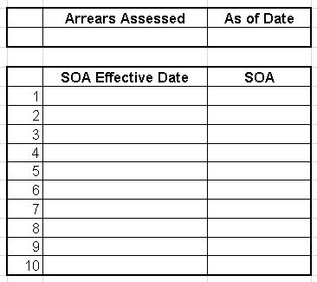
Payment Summary Tab cont.
Any assessed arrears are placed in the top section with the “as of date”.
The SOA entry section allows for the initial SOA and nine SOA changes.

Slide 12

Payment Summary Tab Cont.
Examples: The date of the emancipation of the child, death of a case member, change in custody, the court terminates child support, etc.
This should remain 12/31/9999 at all other times.
This section indicates that the reconciliation should not charge after this date.

Slide 13
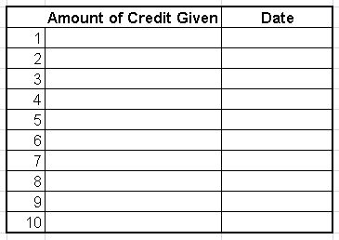
Payment Summary Tab cont.
Used to add any credits or debits that occurred on the case that are not on the payment summary.
Example: The court gives NCP credit for direct payments to the CP.
Positive amounts for credits.
Negative amounts for debits.

Slide 14
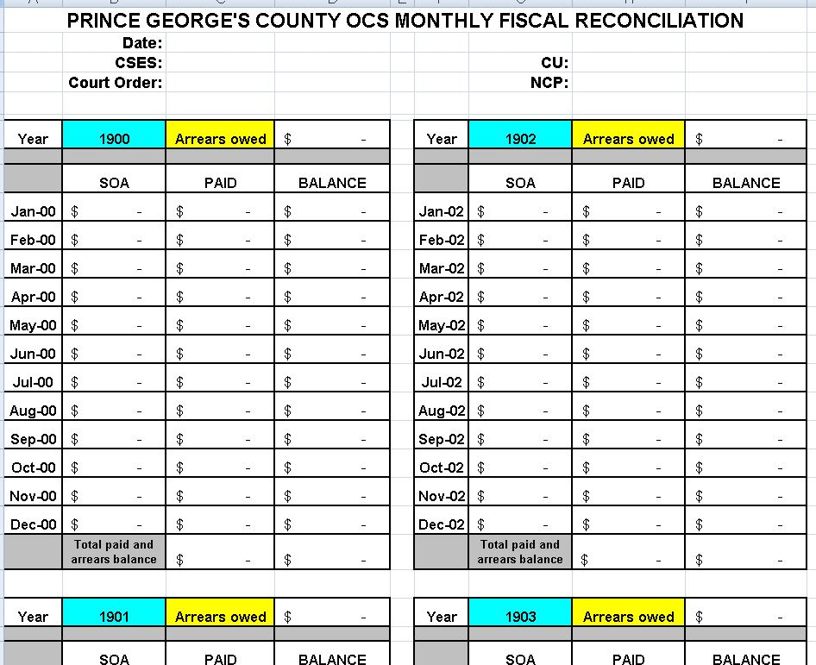
Fiscal Reconciliation Pages
The layout of each page is the same.
A header section and the “Year Blocks” will show the calculated reconciliation.

Slide 15
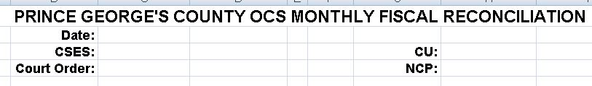
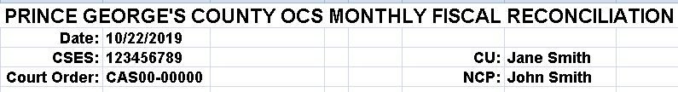
Fiscal Reconciliation Pages
The header section on PAGE 1 allows you to edit the jurisdiction and case information.
This information carries over to the remaining pages.

Slide 16
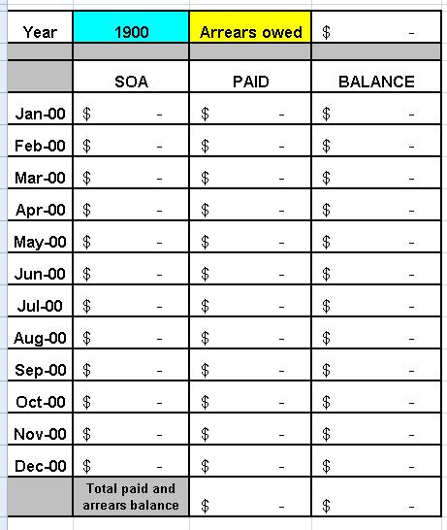
Fiscal Reconciliation Pages: The Year Block
The Year Block holds the SOA, payment, and balance information based on the information entered on the Payment Summary Page.

Slide 17

Total Paid and Arrears Balance
At the bottom of each Year Block there is a total paid and arrears balance section.
This will populate once the SOA and Payment Summary is entered on the Payment Summary Tab.

Slide 18
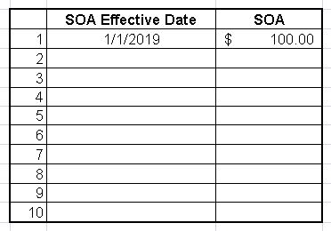
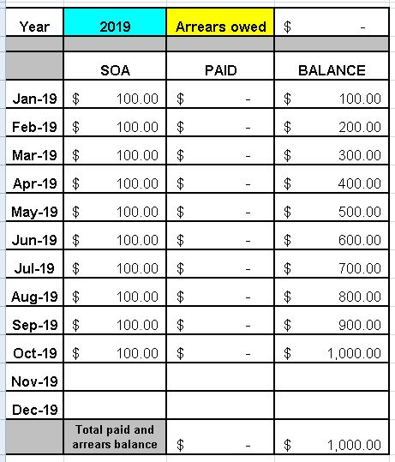
Summary Page and Reconciliation Functionality
Enter an SOA Effective Date and an SOA on the Payment Summary Tab.
The Year Block updates with the year and the SOA information up to the present month.

Slide 19

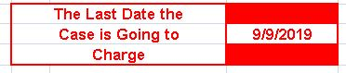
Summary Page and Reconciliation Functionality
If the last date the case is going to charge is entered, the charging stops in that month.

Slide 20
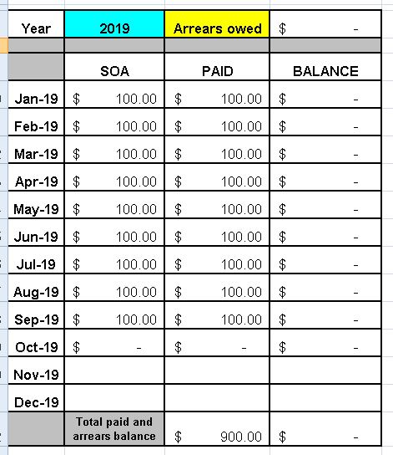
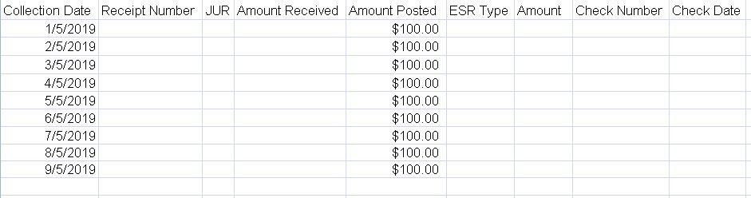
Summary Page and Reconciliation Functionality
When the payment summary is copied into the Payment Summary Tab, the payments will populate the Year Block in the appropriate month.

Slide 21
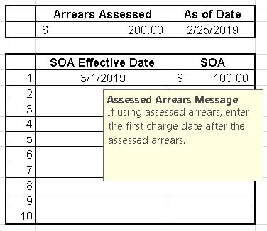
Summary Page and Reconciliation Functionality
Assessed arrears and the assessed “as of” date can be entered on the Payment Summary Tab.
When entering assessed arrears, make sure that the first SOA Effective Date is the first charge date after the assessed arrears date.

Slide 22
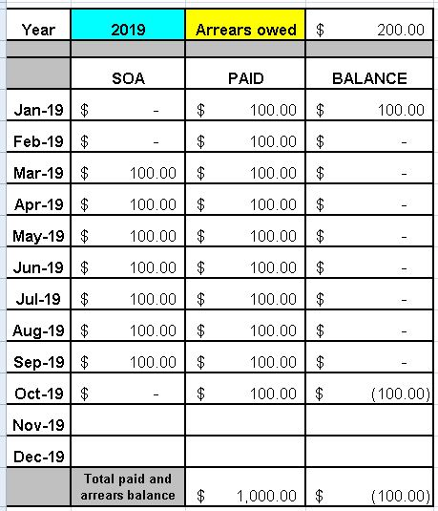
Summary Page and Reconciliation Functionality
The Workbook is set up to read every payment on the Payment Summary Tab.
Therefore, payments before the assessed arrears will be in the Year Block.

Slide 23
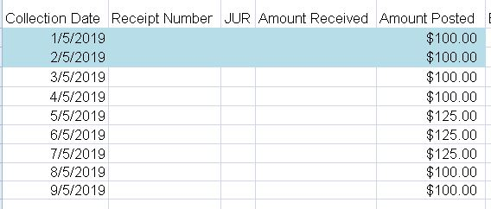
Summary Page and Reconciliation Functionality
In order to have the Workbook to read only the payments it should, you must remove the payments before the assessed arrears date from the Payment Summary Tab.

Slide 24
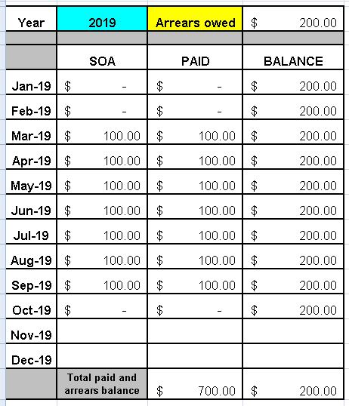
Summary Page and Reconciliation Functionality
The reconciliation now shows only the payments after the assessed arrears.
At the bottom, the total paid only includes payments made after the assessed arrears.

Slide 25
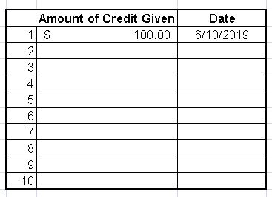

Summary Page and Reconciliation Functionality
Enter any credits on the Payment Summary Tab.
In this case the credit will appear in June 2019.
If a debit is necessary enter it as a negative amount.

Slide 26
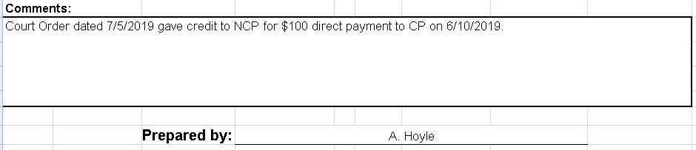
Summary Page and Reconciliation Functionality
The make it clear that a credit has been given, place a comment in the Comments section at the bottom of the PAGE.

Slide 27
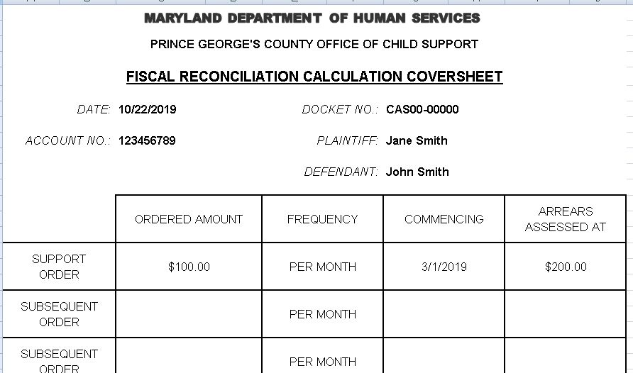
Reconciliation Summary
The Reconciliation Summary Lists the SOAs used in the reconciliation.
It also serves as the coversheet for the full reconciliation.

Slide 28
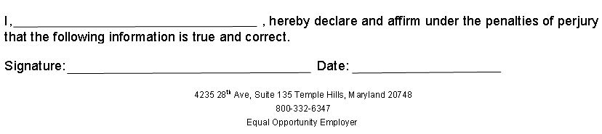
Reconciliation Summary
The bottom section of the Reconciliation Summary is for the user to print their name then sign and date declaring that the information in the Fiscal Reconciliation is true and correct under the penalties of perjury.

Slide 29
Printing the Workbook
The Payment Summary Tab is not intended to be printed.
Each reconciliation page must be printed individually.

Slide 30
Security
Due the sensitive data of a Fiscal Reconciliation, it had to be protected from the tampering of formulas.
The Workbook Pages are locked down and password protected except for the top of PAGE 1 where you can enter your Jurisdiction Name and case information.
You will not be allowed to change anything else on the PAGES.

Slide 31


Slide 32
Contact Information
Charise Proctor
  Charise.proctor@maryland.gov
Aileen Hoyle
  aileen.hoyle@maryland.gov

